Slide 1

SAP Application Interface Framework (AIF)
Deloitte Consulting LLP

Slide 2
AGENDA
Application Interface Framework
Interface Monitoring
Interface Error Handling
Monitoring and Error Handling
Error Message Reprocessing
Alerts and Notification
Configure Alerts
Alerts, Recipients and Key Fields
Recipient assignment
Interface Implementation with SAP AIF
Structure Mappings
Fix Values
Value Mapping
Checks
Actions
AIF Technical testing and debugging

Slide 3
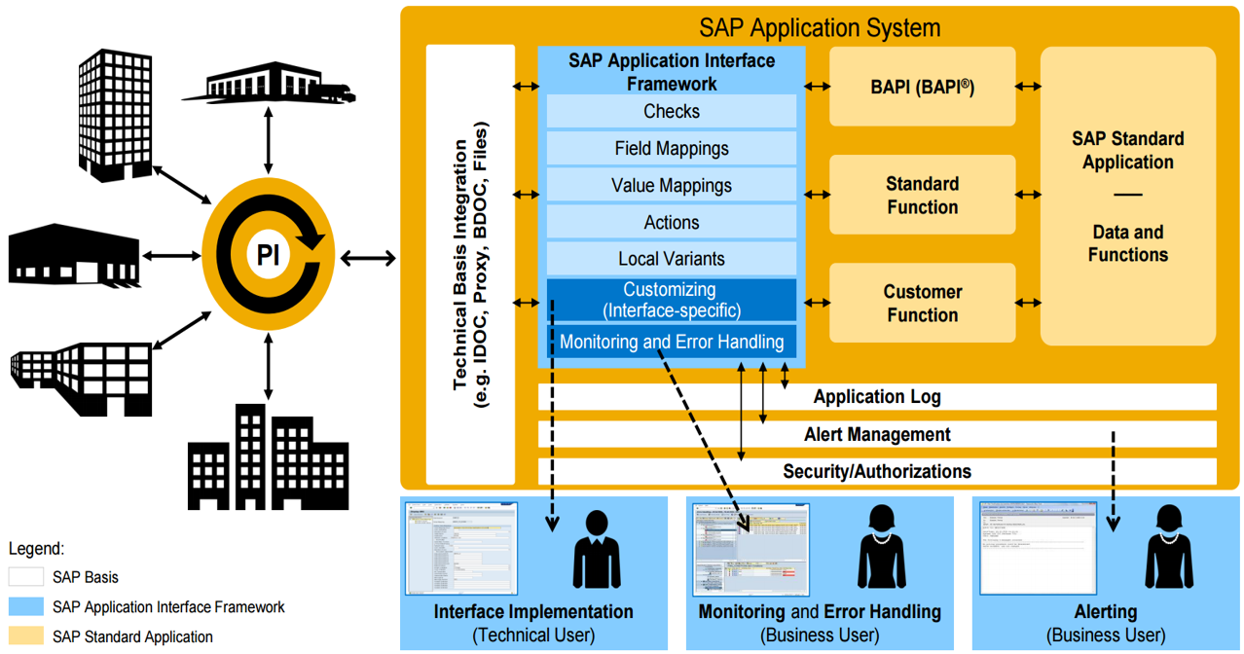
Application Interface Framework – Introduction and Architecture Overview
SAP Application Interface Framework is a powerful framework for Interface implementation, monitoring and error handling.
Interface Implementation
Interface implementation through Customizing menus
Reuse of Interface components (e.g. checks, mappings,
actions)
Independent implementation and testing of Interface
components
Works for inbound / outbound synchronous and
asynchronous Interfaces
Monitoring and Error handling
Business user monitoring
Customizable authorizations for Interface access
Alerting and notification capabilities also available based
on message content
Capabilities for mass error handling
Auto processing feature
Payload editor available

Slide 4
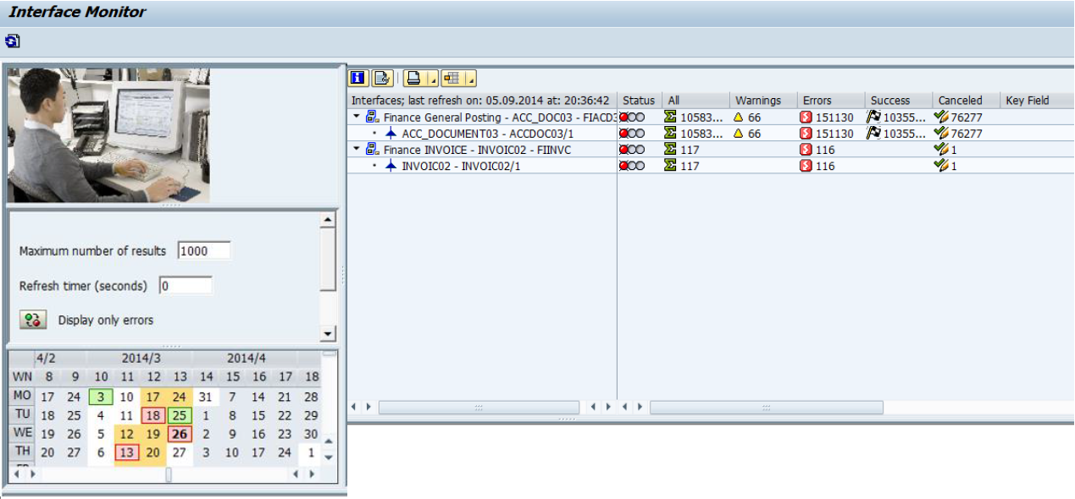
Application Interface Framework – Interface Monitoring
Personalized overview of Interfaces using t-code /AIF/IFMON. In calendar control, the days when messages are in the system are highlighted depending on the highest error status as follows:
Red: There are error messages for this one day.
There could also be successful, canceled, and warning
messages for this day.
Yellow: There are only warning messages,
or both warning and successful or canceled messages,
and no error messages for this one day.
Green: There are only successful or canceled messages
for this one day.

Slide 5
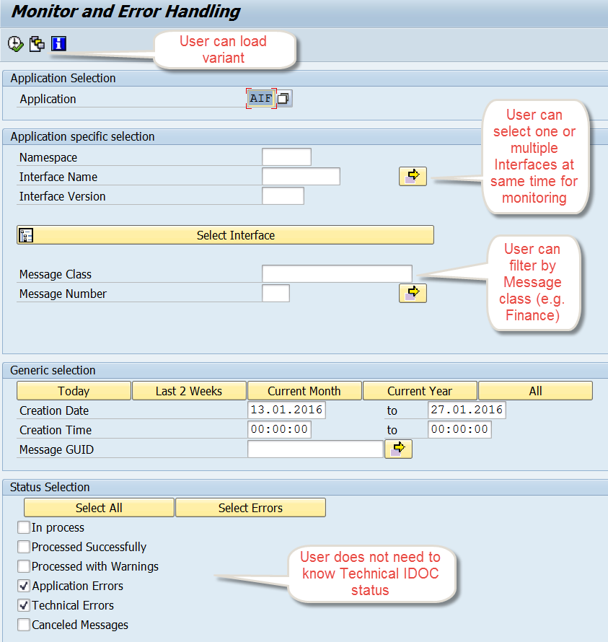
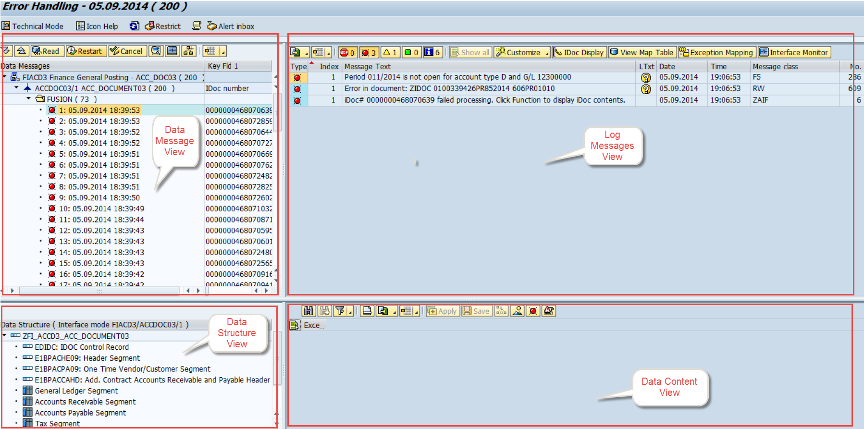
Application Interface Framework – Interface Error Handling
T-Code - /n/AIF/ERR. AIF shows multiple errors per IDOC, and not just the main message as in IDOC monitoring BD87 etc.
AIF provides capabilities for mass error handling.
Provides ability to correct errors within the system on user friendly screens.
User alerts in case of errors

Slide 6
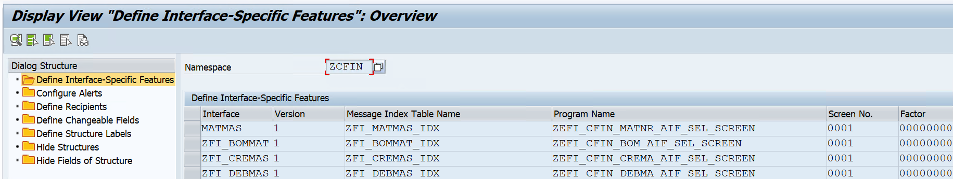
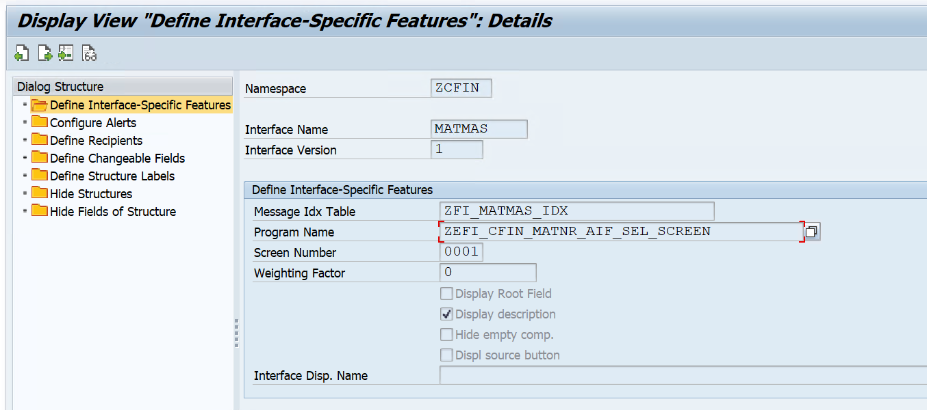
Application Interface Framework – Interface Error Handling [Contd..]

Slide 7
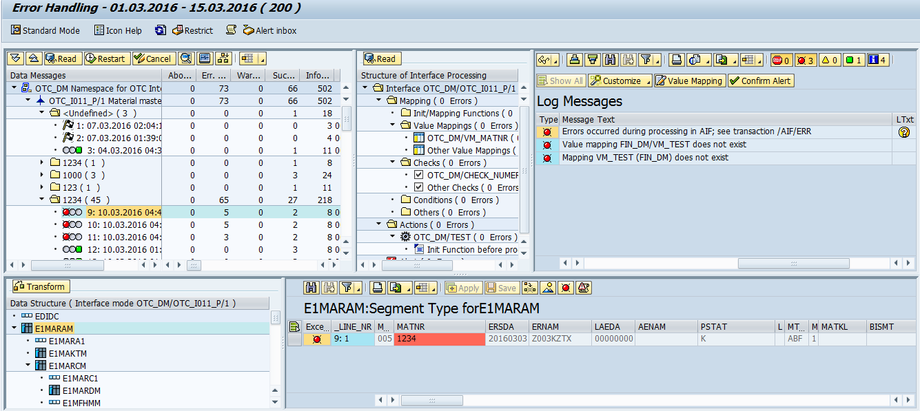
Monitoring and Error Handling

Slide 8
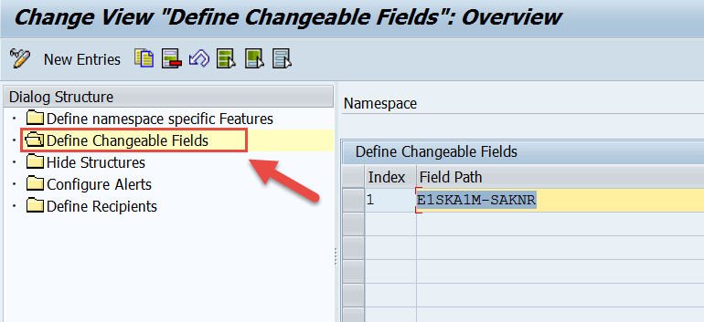
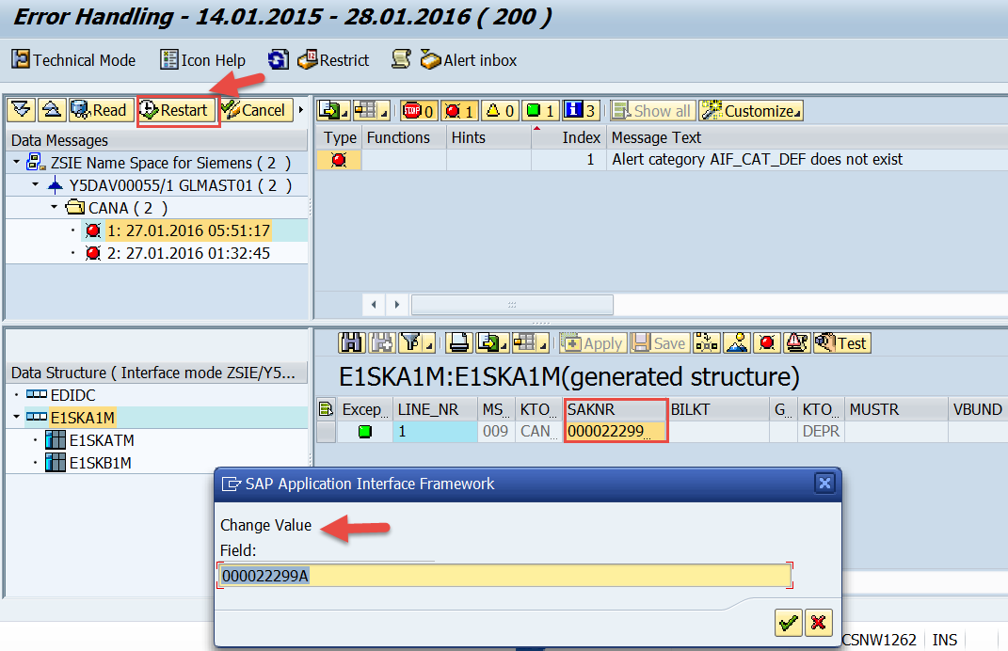
Application Interface Framework – Error Message Reprocessing
T-Code - /n/AIF/ERR
Allows to edit the payload / data
Allows to re-process or cancel the error messages
Can be used for both automatic and manual error processing
Restricts visibility of Interface data to unauthorized users
Restricts the fields that could be modified before reprocessing

Slide 9
Application Interface Framework – Alerts and Notification

Slide 10
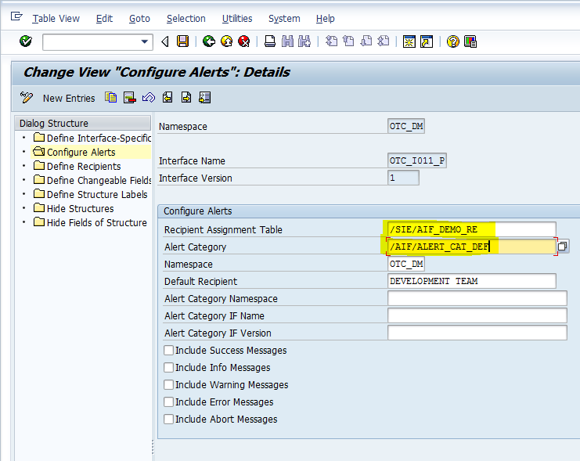
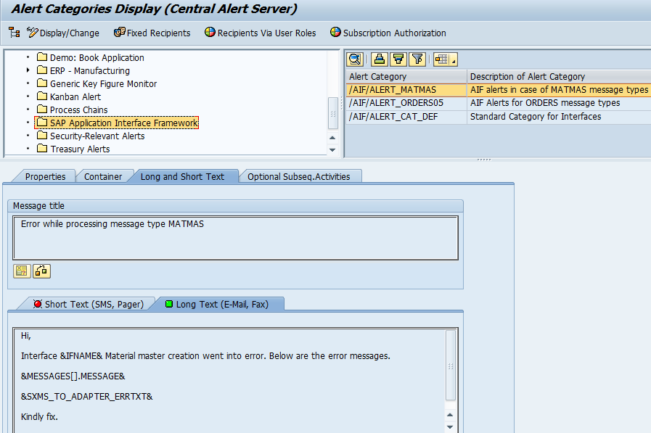
Configure Alerts
Define Namespace Specific Features Transaction - ALRTCATDEF

Slide 11
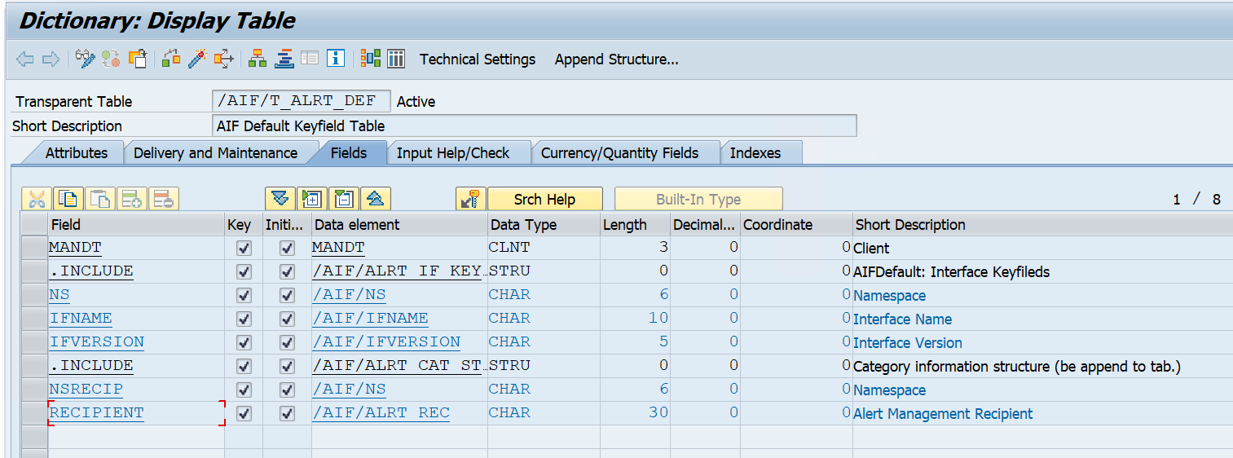
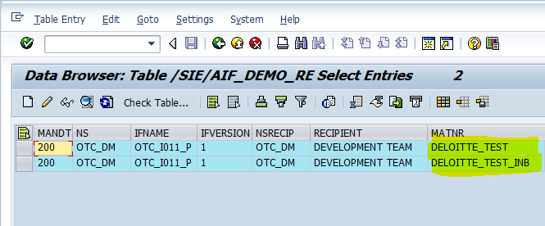
Alerts, Recipients and Key Fields
In transaction /N/AIF/ERR, we can group our interfaces based on a key field; e.g. plant, company code etc.
We can send the alerts to the assigned Recipients based on the key field. e.g. Team A should get the alert if the company code/plant is ‘XXXX’.
To use a key field-dependent recipient assignment, you have to create a recipient assignment table.
Define Recipients: The recipients defined here will be notified by alerts whenever error occurs.

Slide 12
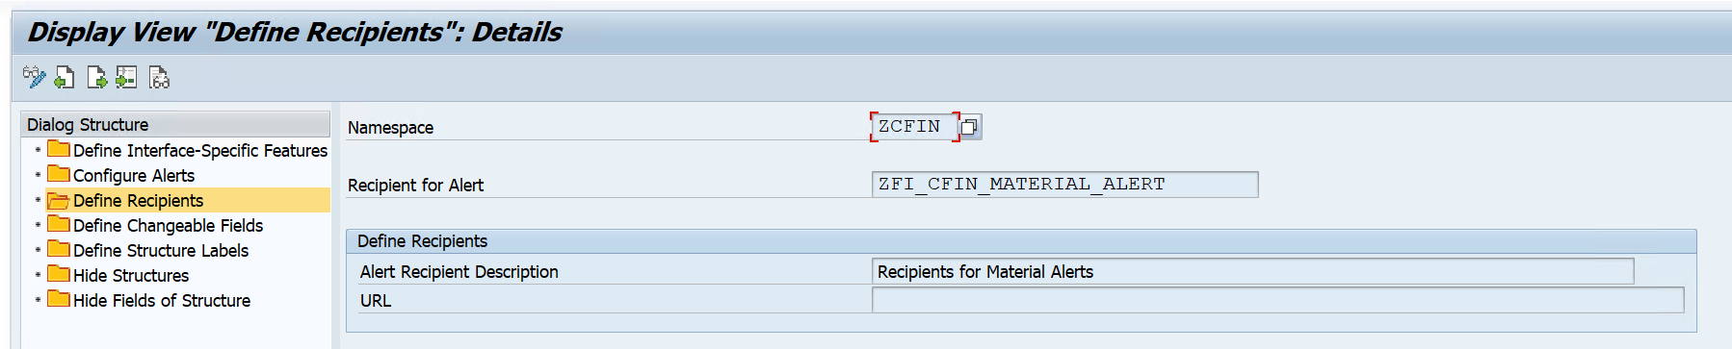
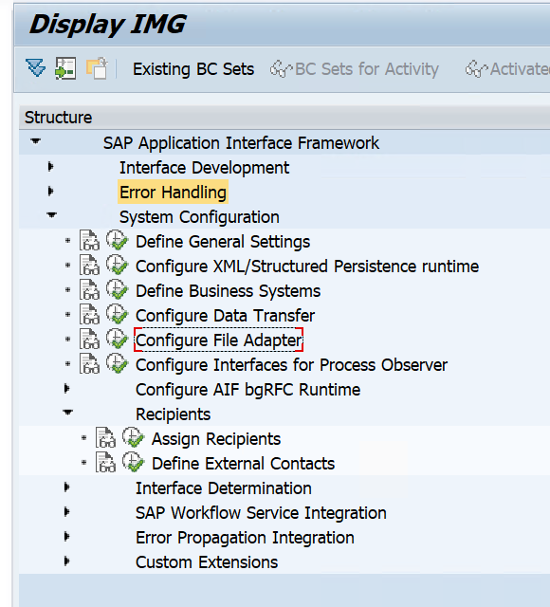
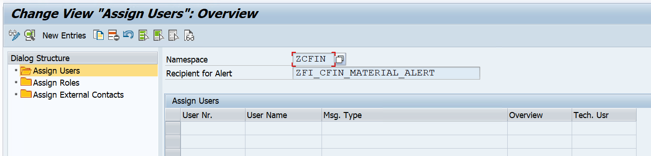
Recipient assignment

Slide 13
Interface Implementation with SAP AIF
Pre-requisites:
Create SAP & Raw Data Structure.
Define AIF Application (/AIF/CUST).
Namespaces
Logical structuring of objects and configuration
Locking mechanisms and Authorizations
Interface
An interface is the technical representation of a system interface
Connection point between the application data (SAP data structure) and the data in the external format (raw data structure)
Interface Version
Defines a version of an interface in the SAP Application Interface Framework that is used for processing a data message
A new version of an interface may vary from the original interface

Slide 14
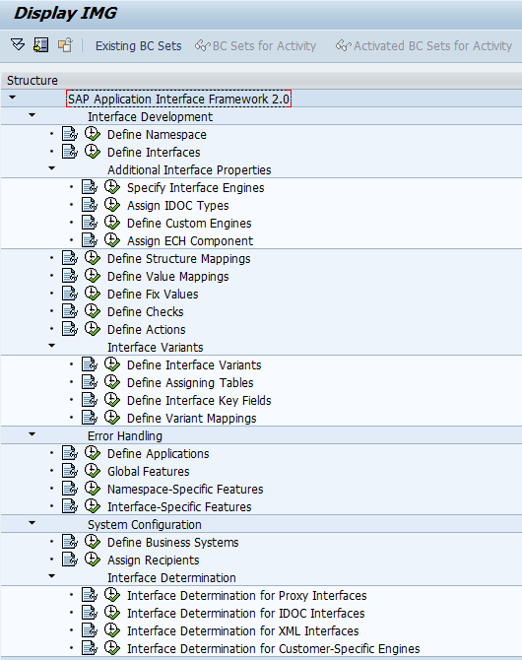
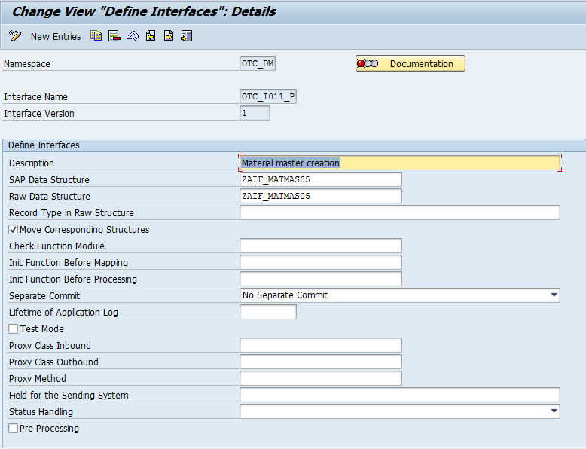
Interface Implementation with SAP AIF [Contd..]

Slide 15
Structure Mappings
In Structure mapping, the fields of the source structure are mapped to the fields of the destination structure.
Various transformation logics can be performed as below:
Define Field Mappings: The fields of the source structure need to be mapped to the fields of the destination structure. This is done using field mappings
Assign Checks: possible to check raw data or SAP data structures. Works based on “Where” condition
Define Fix Values: For a field that is supposed to have the same value every time, you can define a fix value
Define Value Mappings: You can define Value mapping to derive a value in the destination structure from up to five values in source structure

Slide 16
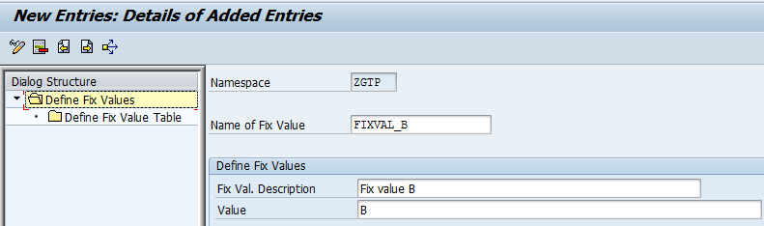
Fix Values
You can use fix values if you want for a certain field in the destination structure to always have the same value.
There are two possibilities to define a fix value. The first possibility is to enter a fix value directly into the structure mapping. The second possibility is to create a named fix value, which can be assigned to a field in the structure mapping.

Slide 17
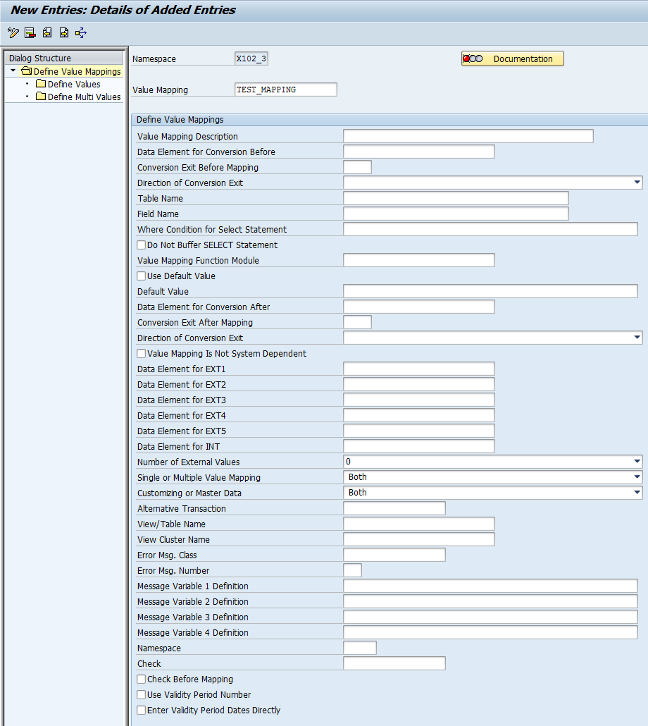
Value Mapping
Value mappings are used to derive one value in the destination structure from up to five values in the source structure and can be optionally enriched with further data from the backend system.
Value mappings can be derived from
Database table
Internal value mapping table
Value mapping function module
Default value

Slide 18
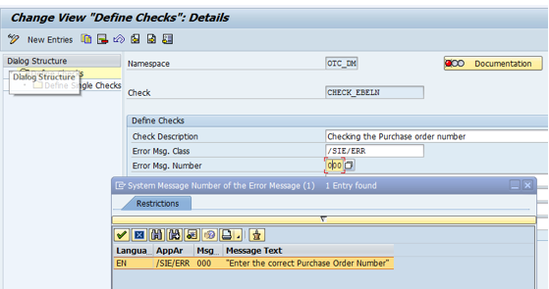
Checks
Checks can be created by choosing Define Checks and entering the namespace for which you want to create the check.
Error message, which is written to the application log if the check fails, can be defined.
Up to four variables can be defined to be used in the message. You can enter either constant values or placeholders that are replaced at runtime.
There a several ways to define a check:
Field Check: A check can be selected from
the drop-down box. Only if the field value fits
the selected criteria, is the check successful.
DB Table Check: To check if value exists or
not in DB Table fields.

Slide 19
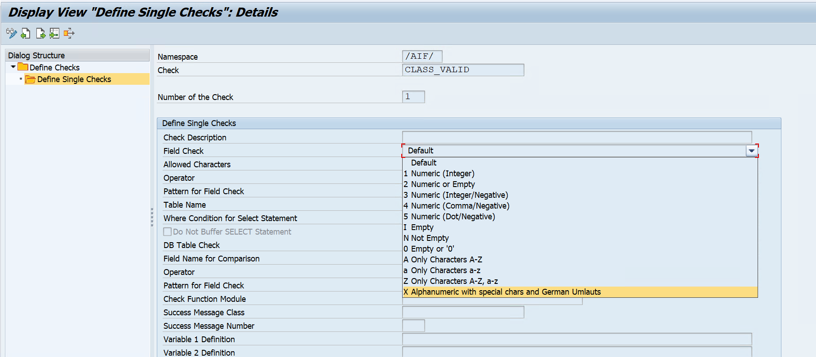
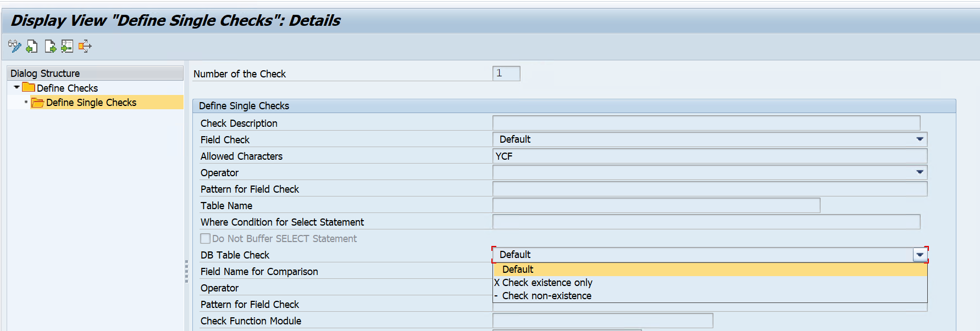
Checks [Contd..]

Slide 20
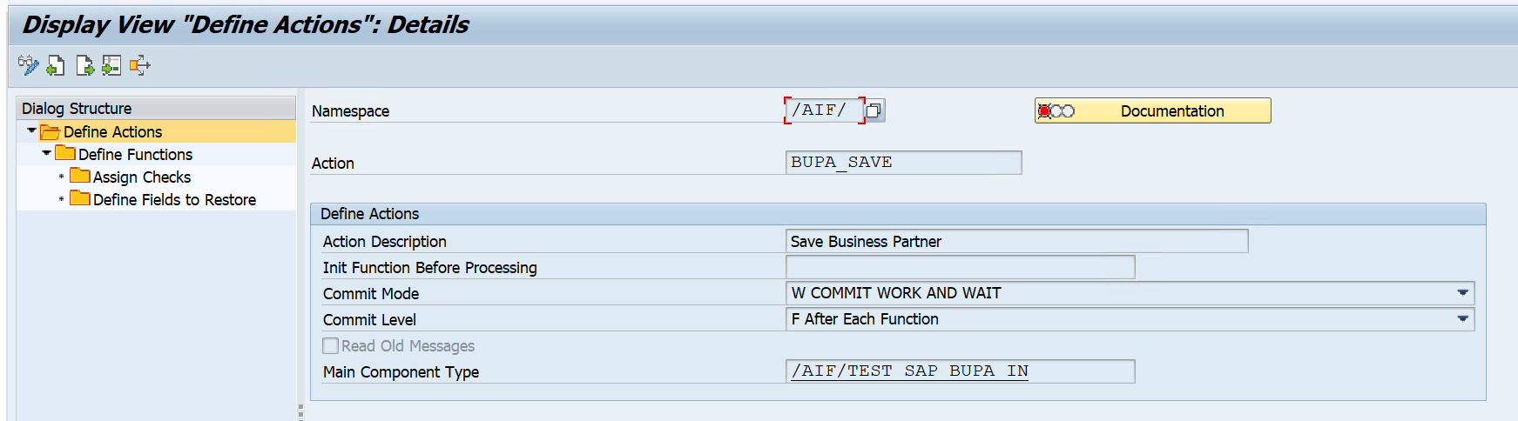
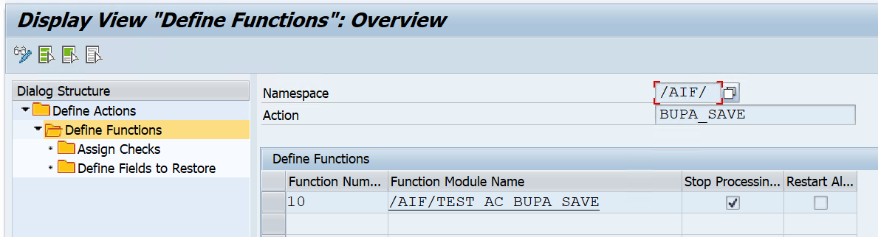
Actions
Actions define the processing steps of messages in the SAP Application Interfaces Framework. They are responsible for processing business logic at runtime.
An action consists of at least one function module call.

Slide 21
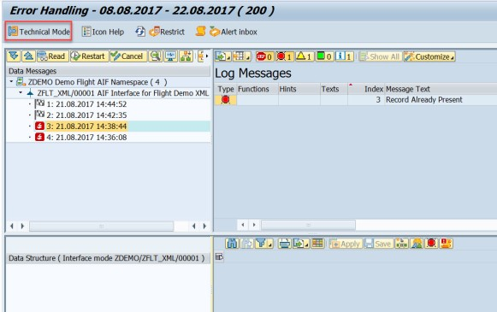
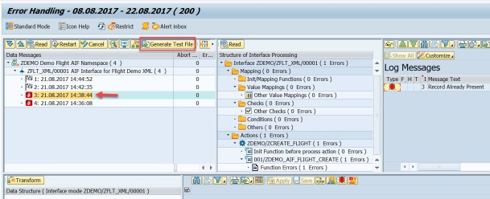
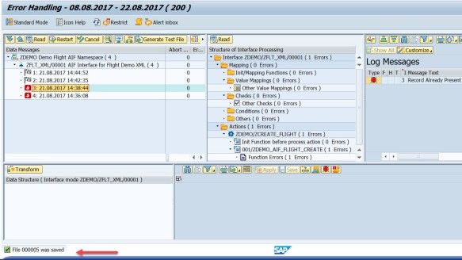
AIF Technical testing and debugging
To test the failed AIF message, test file must be generated from /AIF/ERR Tcode.

Slide 22
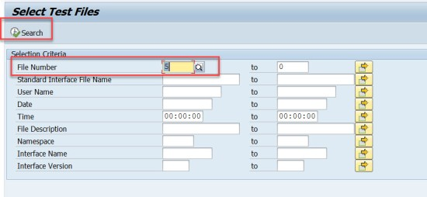
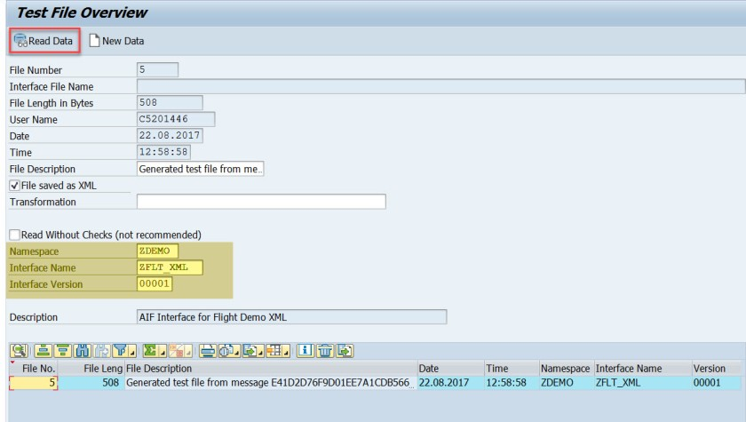
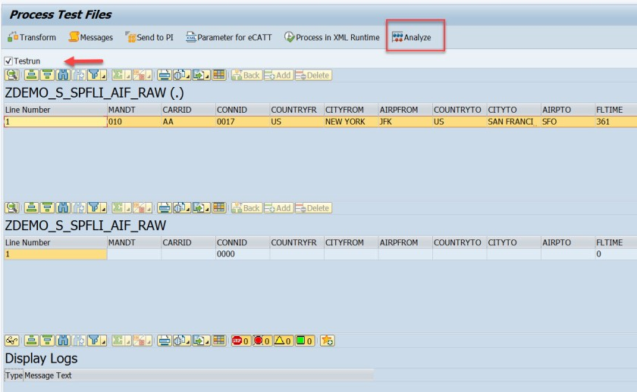
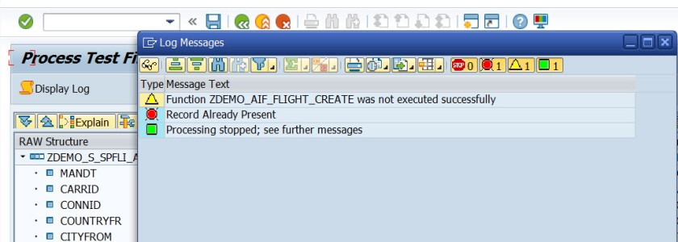
AIF Technical testing and debugging [Contd..]
Use Tcode /AIF/IFTEST to test the interface.

Slide 23
About Deloitte Deloitte refers to one or more of Deloitte Touche Tohmatsu Limited, a UK private company limited by guarantee, and its network of member firms, each of which is a legally separate and independent entity. Please see www.deloitte.com/about for a detailed description of the legal structure of Deloitte Touche Tohmatsu Limited and its member firms. Please see www.deloitte.com/us/about for a detailed description of the legal structure of Deloitte LLP and its subsidiaries. Certain services may not be available to attest clients under the rules and regulations of public accounting. Copyright © 2020 Deloitte Development LLC. All rights reserved. Member of Deloitte Touche Tohmatsu Limited
Notes:
23

